Slide 1
SEPs: Business problem or public policy problem?
Joseph Farrell
Brussels, May 2017

Slide 2
Thoughts on a revisit
My 1991 visit
Lots of fine recent work
  I won’t try to quote or summarize it
Some basic questions seem still to be wide open
  Apologies if I’ve missed your paper
If we can’t actually have ex ante disclosure and negotiation, should we try to move “closer” (how?), or is that a lost cause?
Are SSOs the solution (perhaps with tweaks), the problem, or what?

Slide 3
What is the problem?
Appropriate opportunities and reward for innovation
Avoid competitive problems and/or unduly high prices
Not well matched for ordinary business negotiations

Slide 4
How might it be solved/addressed?
Individual negotiations
  With one or both sides having announced some policies
  Repeated interactions
Ad hoc or informal collectives
  Consortia, pools
Formal and/or official SSOs
  Policies, enforcement, scope
  How does “an SSO” behave, what does it maximize?
Government
  Direct action; constraining or requiring action by others
  Law enforcement (including antitrust); other policy

Slide 5
Repeated interactions (may skip)
Incentives to evolve toward a good outcome?
Clarity of what players have done and should have done?
Credible (and legal) responses that largely deter but with resilience?
  Subgame-perfect equilibrium as usually modeled doesn’t capture difficulty
  Rambus, others

Slide 6
Consortia/pools (may skip)
Patent pools can reflect joint private incentive to address stacking problem, but only down to(wards) monopoly level
  Perhaps they will do more, but as an incentive matter, not clear why
If flexible, may be challenging for participants to sustain
  W-CDMA, LTE attempts

Slide 7
SSOs and government solutions?
My main focus today
Who are SSOs?
  Business coalitions that are somewhat attuned to public policy?
  Somewhat privatized agents of society in somewhat governmental way?
Incentives of SSOs
  Collective welfare (profits) of active members?
  Tilt toward more weight on benefits to members that might leave
    Exit and/or voice
Putting the “AND” into “FRAND”

Slide 8
Evaluation
Incentives
  How well a group’s or institution’s interests are aligned with society’s, or with solving the problem (opportunities and fair rewards) at hand
Competence
  Information and expertise
Shadow principle: If parties negotiate in the shadow of a decision mechanism, incentives matter more than competence!
  More than just “on average it works”
  Errors that will be random mostly won’t be allowed to actually occur
  Investments, decisions made before random errors occur, if they do
  Analogy with statistics?—bias versus random error

Slide 9
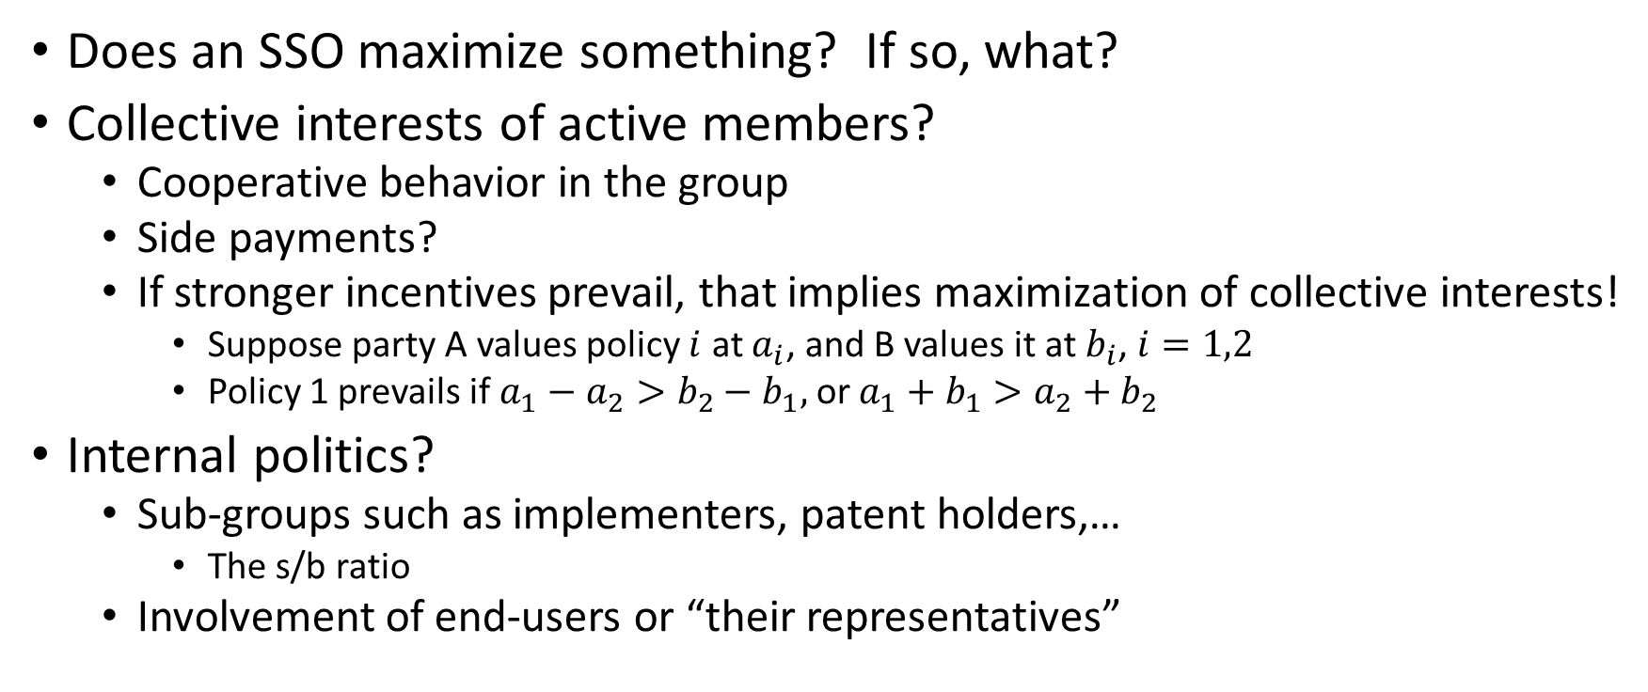
SSO incentives (1)
Does an SSO maximize something? If so, what?
Collective interests of active members?
  Cooperative behavior in the group
  Side payments?
  If stronger incentives prevail, that implies maximization of collective interests!
    Suppose party A values policy $i$ at $a_{i}$, and B values it at $b_{i}$, $i=1,2$
    Policy 1 prevails if $a_{1}−a_{2}>b_{2}−b_{1},$ or $a_{1}+b_{1}>a_{2}+b_{2}$
Internal politics?
  Sub-groups such as implementers, patent holders,…
    The s/b ratio
  Involvement of end-users or “their representatives”

Slide 10
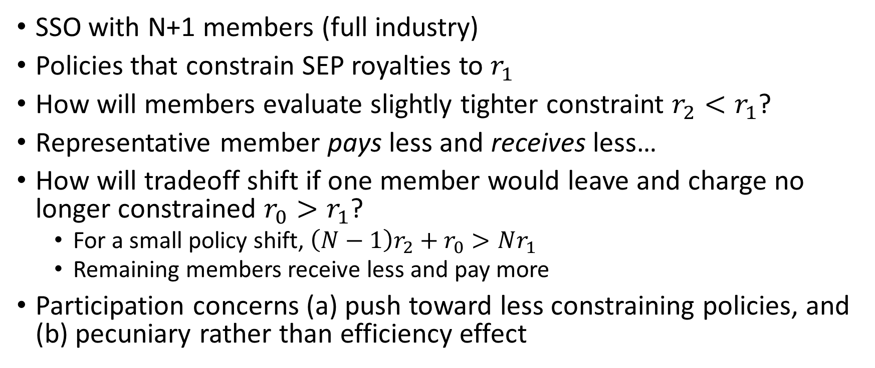
Participation if FRAND is membership-linked
SSO with N+1 members (full industry)
Policies that constrain SEP royalties to $r_{1}$
How will members evaluate slightly tighter constraint $r_{2}<r_{1}$?
Representative member pays less and receives less…
How will tradeoff shift if one member would leave and charge no longer constrained $r_{0}>r_{1}$?
  For a small policy shift, $\left(N−1\right)r_{2}+r_{0}>Nr_{1}$
  Remaining members receive less and pay more
Participation concerns (a) push toward less constraining policies, and (b) pecuniary rather than efficiency effect

Slide 11
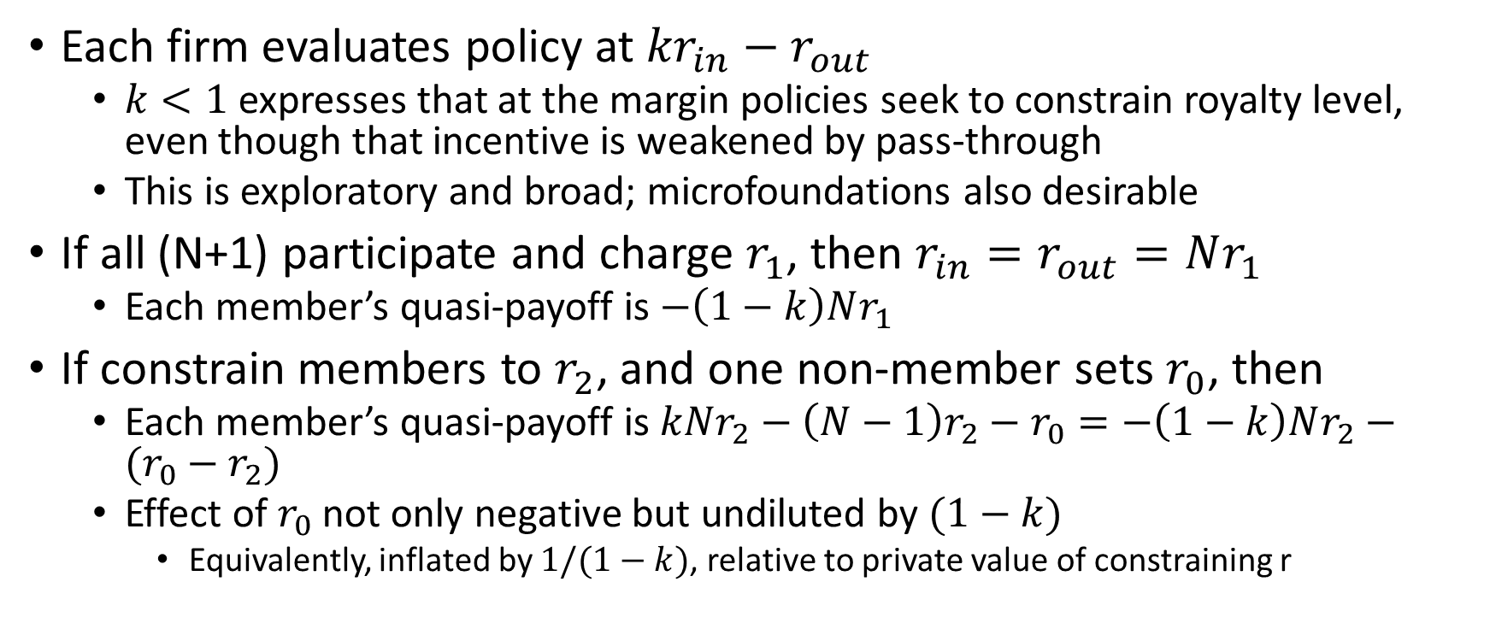
Example
Each firm evaluates policy at ${kr}_{in}−r_{out}$
  $k<1$ expresses that at the margin policies seek to constrain royalty level, even though that incentive is weakened by pass-through
  This is exploratory and broad; microfoundations also desirable
If all (N+1) participate and charge $r_{1}$, then $r_{in}=r_{out}=Nr_{1}$
  Each member’s quasi-payoff is $−\left(1−k\right)Nr_{1}$
If constrain members to $r_{2}$, and one non-member sets $r_{0}$, then
  Each member’s quasi-payoff is $kNr_{2}−\left(N−1\right)r_{2}−r_{0}=−\left(1−k\right)Nr_{2}−(r_{0}−r_{2})$
  Effect of $r_{0}$ not only negative but undiluted by $(1−k)$
    Equivalently, inflated by $1/(1−k)$, relative to private value of constraining r

Slide 12
SSO Incentives (2)
Pass-through and incidence of SEP royalties
  Relativity: competing implementers care about relative costs (including licenses)
For a uniform (ND) shift, pass-through logic implies members bear less than full social cost: much is on downstream consumers
  But further exploration is warranted
Are lump-sum royalties a marginal cost in the longer run?
  Sell one more phone today…
  Effect on estimated level and trend of your sales
  Effect on future “lump-sum” licenses

Slide 13
FR and ND
Nice people think F, R, and ND go together
Economists are not so nice, and wonder…
  Pass-through: consumers will pay, so strong ND weakens pressure for FR
But it is more complicated in a bigger policy space
  Each implementer would value lower costs than rivals,
  on average or collectively, they value variation and low costs
  Consumers also value variation and low costs, but differently
  Example: simple Cournot or differentiated-product Bertrand?

Slide 14
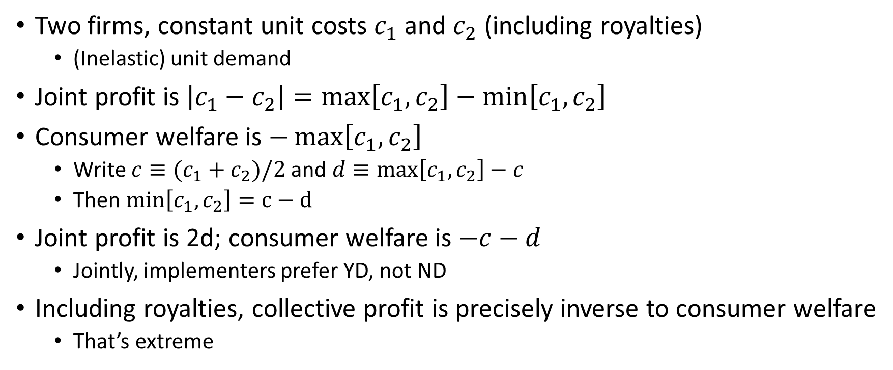
Undifferentiated Bertrand
Two firms, constant unit costs $c_{1}$ and $c_{2}$ (including royalties)
  (Inelastic) unit demand
Joint profit is $\left|c_{1}−c_{2}\right|=\max\left[c_{1},c_{2}\right]−\min\left[c_{1},c_{2}\right]$
Consumer welfare is $−\max\left[c_{1},c_{2}\right]$
  Write $c≡(c_{1}+c_{2})/2$ and $d≡\max\left[c_{1},c_{2}\right]−c$
  Then $min\left[c_{1},c_{2}\right]=c−d$
Joint profit is 2d; consumer welfare is $−c−d$
  Jointly, implementers prefer YD, not ND
Including royalties, collective profit is precisely inverse to consumer welfare
  That’s extreme

Slide 15
Another perspective on ND
Economics of exclusive dealing shows how ability to discriminate helps manipulate multiple “buyers” into accepting deals that harm them
  Relies on mechanism parallel to network effects
  Commit to recruiting “enough” buyers, and “others” must accede
  Coordination problem arises without discrimination but…
Do such concerns help explain role of ND in SSOs?

Slide 16
Government incentives and competence
Rather than government or SSOs, how they interact
  In particular, government oversight/requirements/limits (antitrust) on SSOs
Intellectual property is activist government policy
  Compare too-broad arguments e.g. “repeated play or VI will solve”
Core competencies of government (maybe)
  Appeal to end-users/consumers; complementary to business interests?
  Compulsion: dangerous but valuable
    Participation constraint on SSO policies
Protectionism and concentrated interests?
  Legislatures and courts

Slide 17
Conclusion
Lots of fine work being done; much more to do!
  Advice to the young: be ambitious-enough!
  Somebody’s Three Questions
Institutions that address (or might address) the problems: what are the institutional incentives?
  Loose institutions can’t necessarily be modeled as having “incentives,” but it’s an initial way to ask the question
  Incentives probably matter more than internal competence
    The shadow principle
    Competence can be asked for or bought, if incentives are right
    including for governments

