Slide 2




Academic Platform
Notes:
Bo: Creating a center between different faculties, in different universities, and in collaboration with industry is extremely powerful but also very challenging.
Ulf: We feel we are much stronger together and would like to thank our colleagues at NTNU that made this happen – Johan Hustad, Knut Egelie, Roger Sörheim. We look forward to working even closer in the future.
Bo: Welcome, NTNU! (Clap)

Slide 3
Mission: Transforming Knowledge into Wealth and Welfare
We believe that knowledge is the ultimate renewable resource from which to build sustainable wealth and welfare for the future. However, we acknowledge that the creation, control, and utilization of knowledge required to generate wealth and welfare is far from a simple task – this is why we created CIP.

Slide 4


Re-Defining Intellectual Property
From blocking to building block
Blocking imitation
of physical products
Building innovations, ventures, and markets

Slide 5
Patent Trespass and the Royalty Gap
Exploring the Nature and Impact of ’Patent Holdout’
Bowman Heiden
Deputy Director, CIP bowman.heiden@gu.se

Slide 6
Patent Trespass and the Royalty Gap
Exploring the Nature and Impact of ‘Patent Holdout’
Bowman Heiden
Chalmers University of Technology
University of Gothenburg
Nicolas Petit
University of Liege
University of South Australia
Unrestricted research grants provided by 4iP Council and GMU

Slide 7
Agenda
Frame of reference
Holdout in mainstream economics
Deviation from holdout to holdup
Patent trespass strategies
From royalty stack to royalty gap
Main empirical results

Slide 8

IP and the Tragedy of the Anticommons
Hansen: Recall the lessons of Adam Smith, the father of modern economics. "In competition …"
Everybody: "… individual ambition serves the common good.”
John: Incomplete. Incomplete, okay? Because the best result will come from everyone in the group doing what's best for himself … and the group.
John: Governing dynamics, gentlemen. Governing dynamics. Adam Smith...he was wrong.
Notes:
Theories can be incomplete
Collaboration can occur between the traditional hierarchy and the market
“tragedies” in theory are not found to be tragedies in practice – Elinor Ostrom

Slide 9
Stigler, Nobel Lecture, 1982 on positive v. normative economics
“ …it would be useful to examine the question of whether the attractiveness of the public policy positions associated with a theory has an effect upon the acceptability of the theory.”

Slide 10

Notes:
London Conference
Competitive strategy v. Competition law - who has the power in the telecommunication value chain
It is natural to hear firms discuss how their product satisfy customer needs, but I’m always a little nervous when firms use antitrust language (i.e. protecting consumers) given that their main goal is to maximise profit not increase consumer surplus. If they were really concerned with consumer surplus they could of course cut their profit margin.
The use of the economic term “monopoly” in relation to patents is connected more with a static industrial logic of using patents to block instead a dynamic licensing logic as used in FRAND-enabled standards.
Tragedy of the Commons (Prisoner’s dilemma) to Tragedy of the Anti-Commons (Patent Holdup).
Is there really a thicket?
Technology space is infinite (stars in the sky)
Contractual layer can eliminate problem (e.g. FRAND)
Thickets v. Pools
Patent Holdup - Nepalese Farmer
Gross profit margin - Apple v. Qualcomm
Royalty Stacking v. Profit Stacking - Intel report and gross profit margin
Royalty Stacking v. Royalty Lacking
FRAND is not enough to stop patent holdup. Biddle - Computers have at least 150 FRAND standards - Where’s the holdup?
From patent trolls to patent holdup (and of course it must be worse for standard-enabled products). No because standards are open innovation systems with feedback different than one-off troll scenarios
Difficult to single-out one behaviour in an open innovation system as the whole system operates in the grey area from a traditional industrial antitrust perspective. Changes will have a systemic effect (e.g. removal of injunction impacts both holdup and holdout)
Is it possible that claiming opportunism is an act of opportunism in itself?
Biddle et al. (2010)
An empirical study which identifies 251 technical interoperability standards implemented in a modern laptop computer, and estimates that the total number of standards relevant to such a device is much higher. Of the identified standards, the authors find that 44% were developed by consortia, 36% by formal standards development organizations, and 20% by single companies. The intellectual property rights policies associated with 197 of the standards are assessed: 75% were developed under “RAND” terms, 22% under “royalty free” terms, and 3% utilize a patent pool. The authors make certain observations based on their findings, and identify promising areas for future research.
We were able to allocate 197 of the 251 standards into one of three broad intellectual property model categories: RAND, RF or patent pool (we lacked sufficient information to categorize the remaining 54 standards). Of the 197 we categorized, 148 (75%) were RAND, 43 (22%) were RF, and 6 (3%) utilized a patent pool (see Figure 2).
Intel Response to Senate Hearing (2013)
This “hold-up” problem is greatly compounded by the fact that a single consumer product can incorporate hundreds of standards, and each individual standard can involve hundreds and even thousands of SEPs.13 For example, a typical notebook computer incorporates more than 250 different standards.14 An average smartphone incorporates an estimated 250,000 patents.15

Slide 11
Holdout in mainstream economics
The holdout firm is the property owner and holdout power is a function of the effectiveness of the property rule.
Holdout can be considered both from a distributional and an efficiency perspective.
Holdout corresponds to a situation where strangers do not transact.
Holdout is described as a form of self-interest.

Slide 12
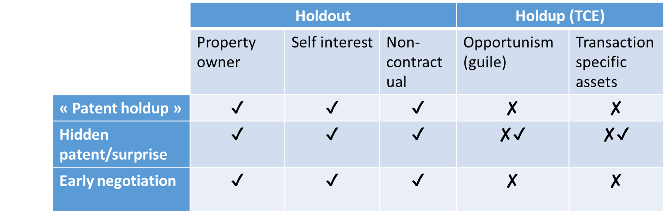
Deviation from holdout to holdup
Normative v. Positive economics
Anchoring in rhetoric not TCE theory
Found in theory but not practice
Terminology and the state of IP economics

Slide 13


Holdup
Holdout

Slide 14

Patent trespass

Slide 15
Patent trespass strategies
Intentional: goals are to eliminate or reduce SEP royalties
More than simply a deferred payment
Linked to strategic market impact beyond revenue sharing – collective action problem
Linked closely to injunctive relief (as is patent holdup)

Slide 16
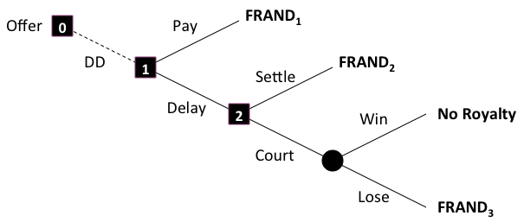
Patent trespass decision model

Slide 17
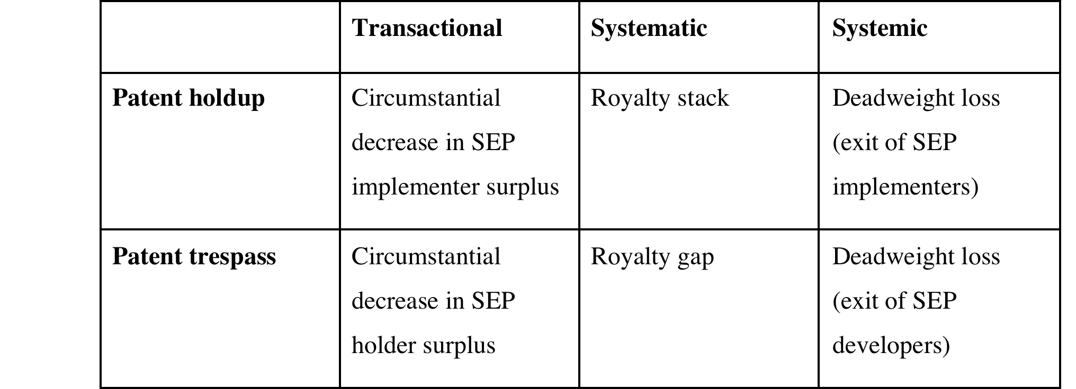
From royalty stack to royalty gap

Slide 18
From royalty stack to royalty gap
 | Transactional | Systematic | Systemic
Patent holdup | Circumstantial reduction to SEP implementer surplus | Royalty stack | Market failure in the product market
Patent trespass | Circumstancial reduction to SEP holder surplus | Royalty gap | Market failure in the technology market

Slide 19
Asymmetrical bargaining power spectrum
SEP Holder
Bargaining Position
(Monopoly Power)
SEP Implementer
Bargaining Position
(Monopsony Power)
Systemic
Systematic
Transactional
Transactional
Systematic
Systemic

Slide 20
Empirical findings
12 SEP licensors
  8 implementing firms
  4 Non-implementing firms
Licensing coverage has declined
Key factors
  Difficulty obtaining injunctive relief
  Licensees in jurisdiction with difficult enforcement
Heterogeneous strategies
  SMEs and LFEs – non-payment strategies
  MNCs – delay and policy strategies

Slide 21
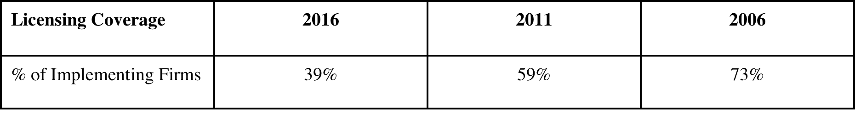
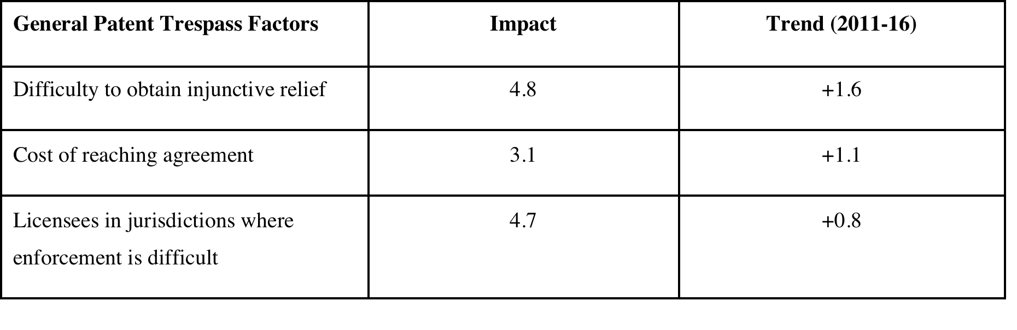
Empirical findings

Slide 22
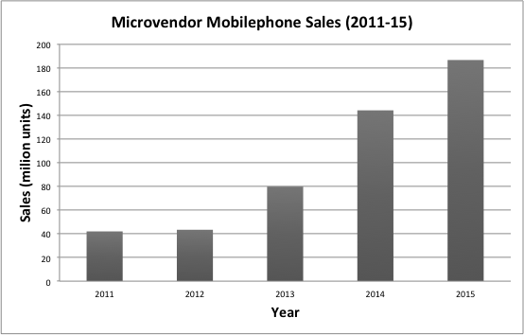
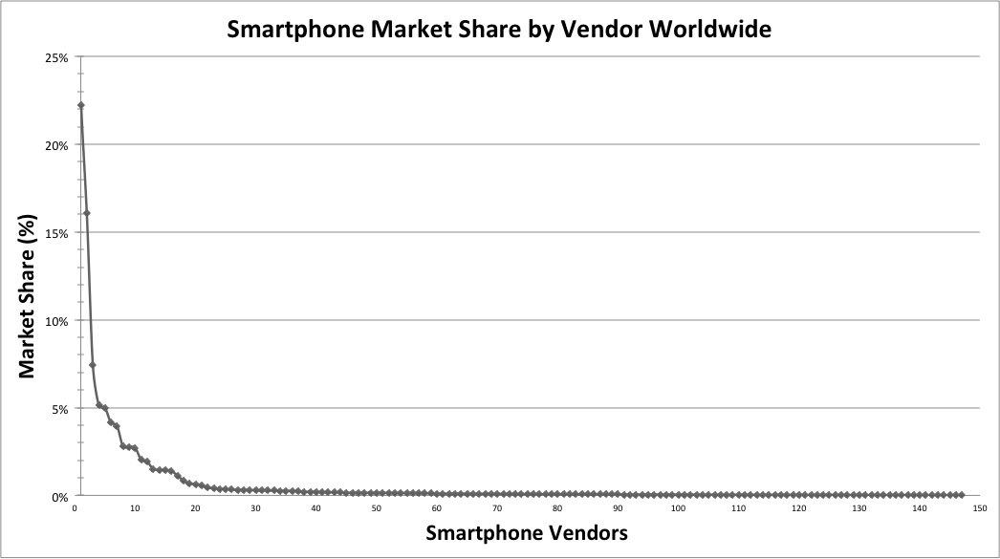
The growing long tail

Slide 23

Notes:
London Conference
Competitive strategy v. Competition law - who has the power in the telecommunication value chain
It is natural to hear firms discuss how their product satisfy customer needs, but I’m always a little nervous when firms use antitrust language (i.e. protecting consumers) given that their main goal is to maximise profit not increase consumer surplus. If they were really concerned with consumer surplus they could of course cut their profit margin.
The use of the economic term “monopoly” in relation to patents is connected more with a static industrial logic of using patents to block instead a dynamic licensing logic as used in FRAND-enabled standards.
Tragedy of the Commons (Prisoner’s dilemma) to Tragedy of the Anti-Commons (Patent Holdup).
Is there really a thicket?
Technology space is infinite (stars in the sky)
Contractual layer can eliminate problem (e.g. FRAND)
Thickets v. Pools
Patent Holdup - Nepalese Farmer
Gross profit margin - Apple v. Qualcomm
Royalty Stacking v. Profit Stacking - Intel report and gross profit margin
Royalty Stacking v. Royalty Lacking
FRAND is not enough to stop patent holdup. Biddle - Computers have at least 150 FRAND standards - Where’s the holdup?
From patent trolls to patent holdup (and of course it must be worse for standard-enabled products). No because standards are open innovation systems with feedback different than one-off troll scenarios
Difficult to single-out one behaviour in an open innovation system as the whole system operates in the grey area from a traditional industrial antitrust perspective. Changes will have a systemic effect (e.g. removal of injunction impacts both holdup and holdout)
Is it possible that claiming opportunism is an act of opportunism in itself?
Biddle et al. (2010)
An empirical study which identifies 251 technical interoperability standards implemented in a modern laptop computer, and estimates that the total number of standards relevant to such a device is much higher. Of the identified standards, the authors find that 44% were developed by consortia, 36% by formal standards development organizations, and 20% by single companies. The intellectual property rights policies associated with 197 of the standards are assessed: 75% were developed under “RAND” terms, 22% under “royalty free” terms, and 3% utilize a patent pool. The authors make certain observations based on their findings, and identify promising areas for future research.
We were able to allocate 197 of the 251 standards into one of three broad intellectual property model categories: RAND, RF or patent pool (we lacked sufficient information to categorize the remaining 54 standards). Of the 197 we categorized, 148 (75%) were RAND, 43 (22%) were RF, and 6 (3%) utilized a patent pool (see Figure 2).
Intel Response to Senate Hearing (2013)
This “hold-up” problem is greatly compounded by the fact that a single consumer product can incorporate hundreds of standards, and each individual standard can involve hundreds and even thousands of SEPs.13 For example, a typical notebook computer incorporates more than 250 different standards.14 An average smartphone incorporates an estimated 250,000 patents.15

