Slide 1
What is the question to which rethinking SSO’s is the answer?
Stephen Haber
LCII-TILEC Conference, Brussels Belgium
May 30, 2017

Slide 2
Purpose of this presentation
To inject facts into a debate about how SSO’s can work to avoid “patent holdup and royalty stacking.”

Slide 3
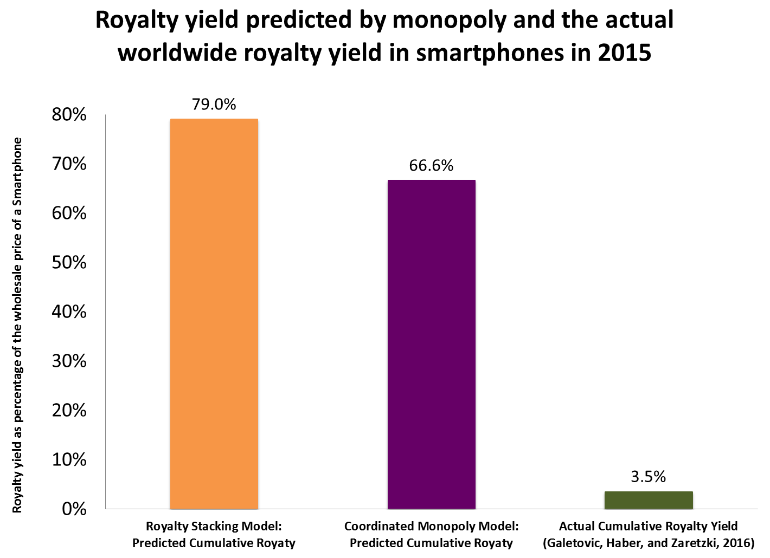
Is there any evidence of royalty stacking by technology development companies in the smartphone ecosystem?

Slide 4
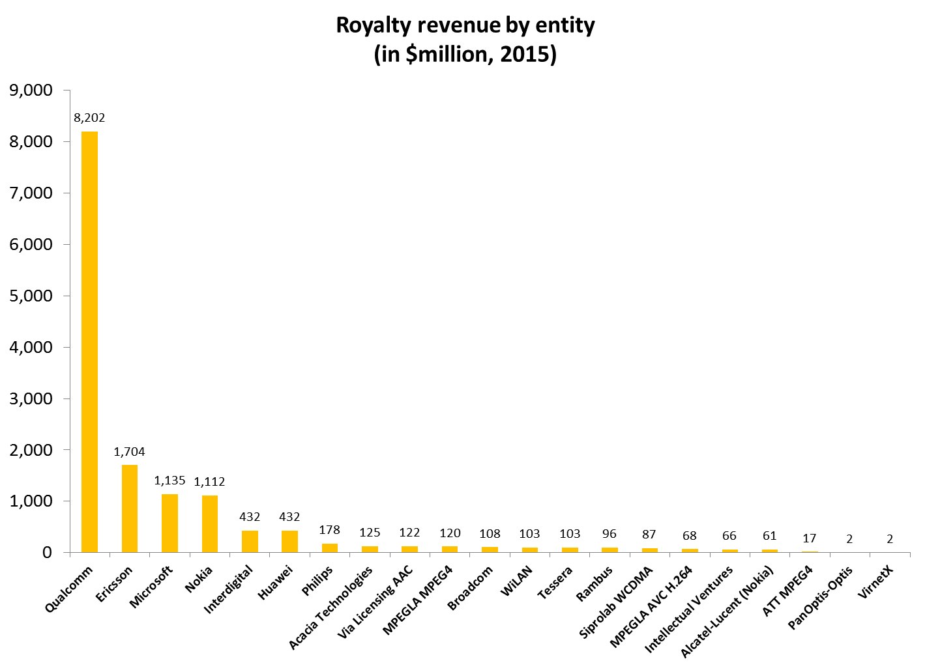
Our estimates include any company that earns significant patent royalty revenue from the smartphone ecosystem, regardless of where it is earned in the supply chain

Slide 5
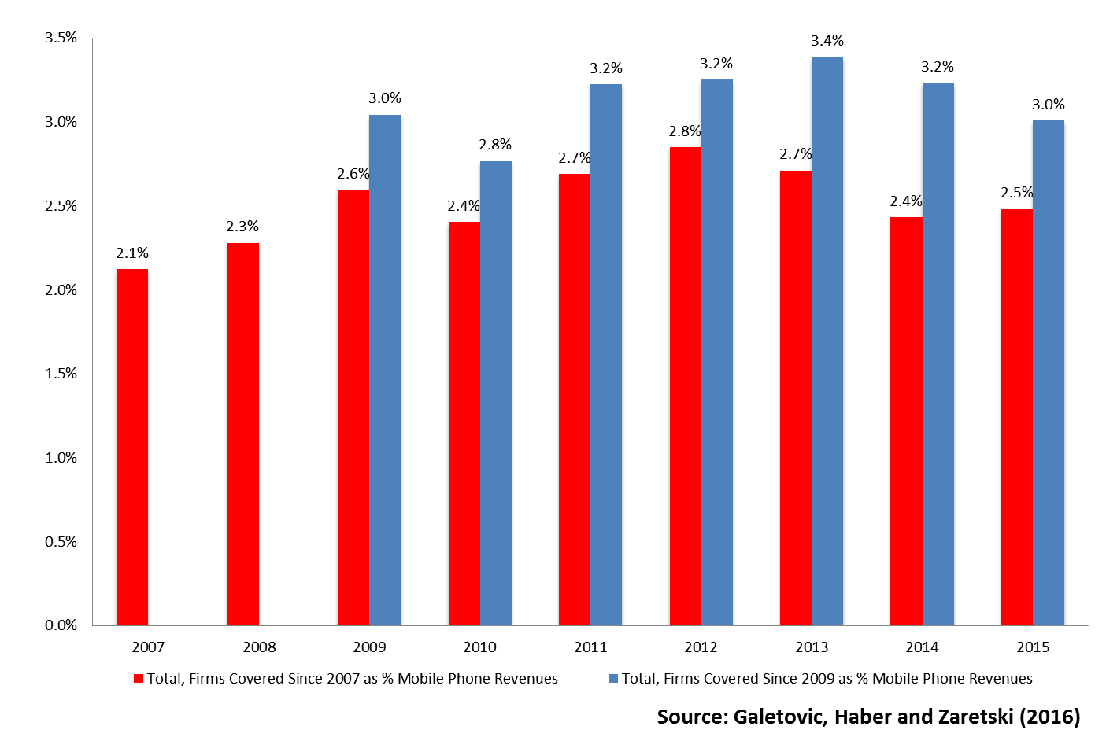
A cumulative royalty yield of roughly 3.5% has been stable over time

Slide 6
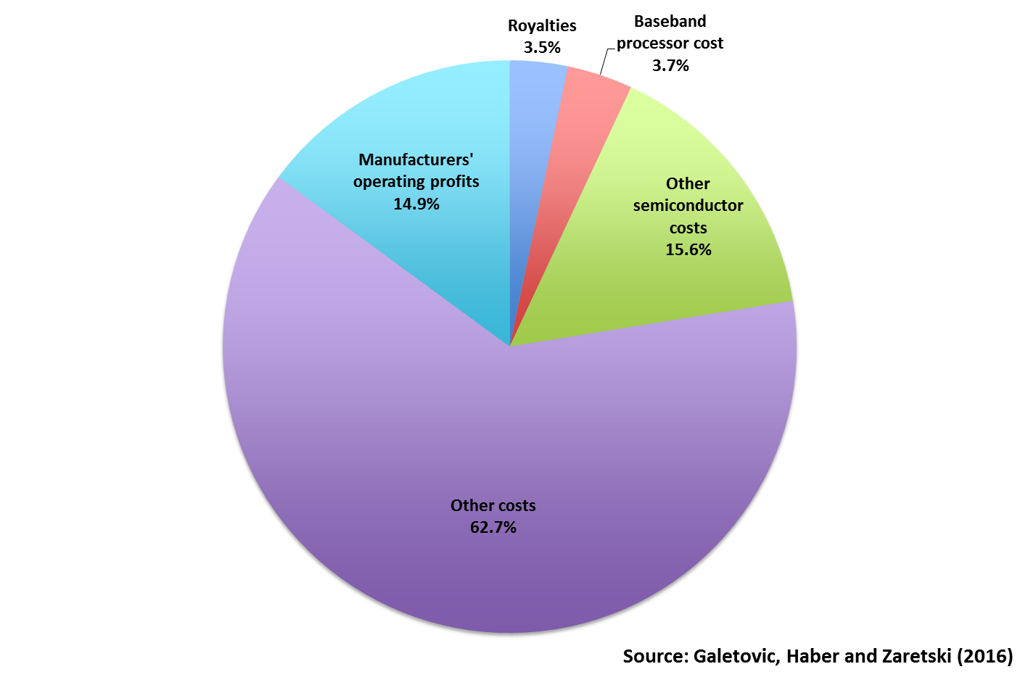
The breakdown of smartphone wholesale revenue in 2015 (ASP = 100%)

Slide 7
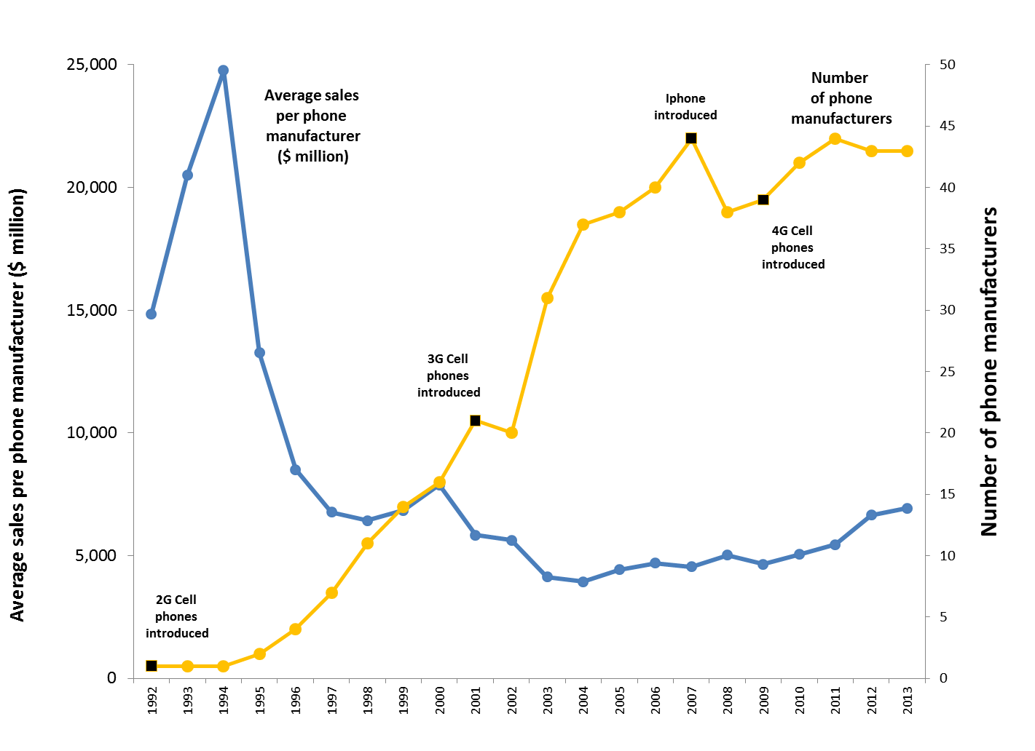
The mobile phone industry has been characterized by high levels of entry
Source: Galetovic and Gupta (2016)

Slide 8
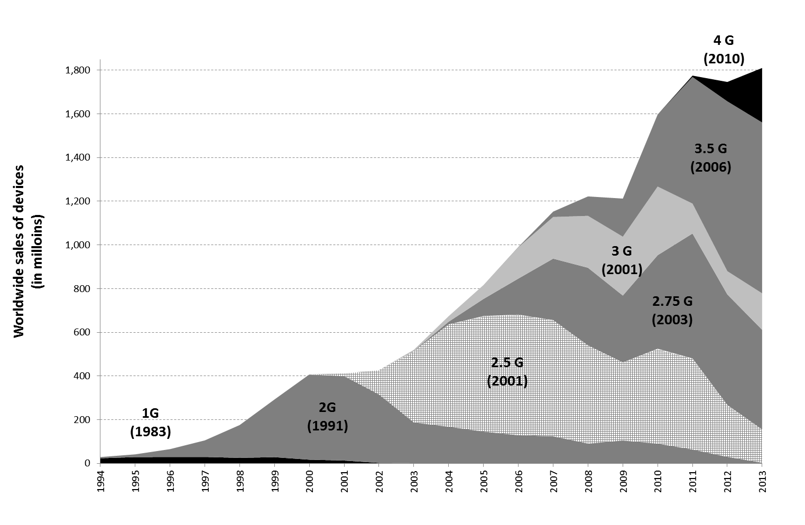
Consumers have adopted mobile phones rapidly
(Annual worldwide sales of devices by technological generation, 1983-2013)
Source: Galetovic and Gupta (2016)

Slide 9
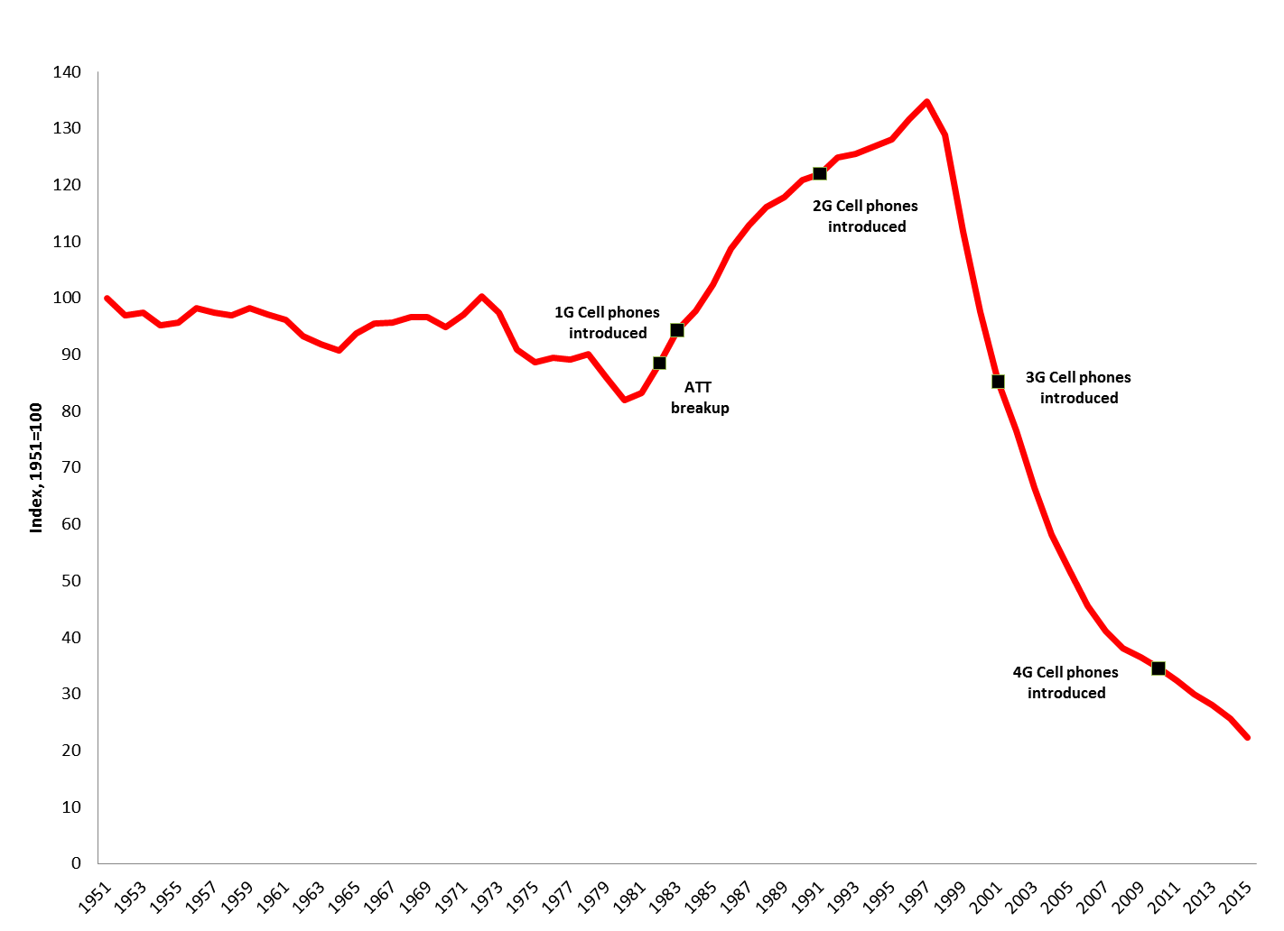
There has been rapid technological advance precisely during the period when technology development companies and implementers specialized
(Quality-Adjusted Relative Prices of Telephone Equipment according to the US BEA, 1951-2015)
Source: Galetovic, Haber and Levine (2015)

Slide 10
Is the SSO debate about a public policy problem, or about supply chain management by low R&D implementers?

