Slide 1
FRAND: RULES V. STANDARDS?
Nicolas Petit, University of Liege (ULg)
LCII-TILEC Conference
Brussels, 29 May 2017

Slide 2
Rules v Standards
Law can prohibit:
  « driving in excess of 60 mph on expressways »
  « driving unreasonably fast »
In a standard, the content of the law is specified ex post by the adjudicator
In a rule, the content (or some of it) of the law is specified ex ante by a rule-maker

Slide 3
Relevance to FRAND-pledged SEPs
Policy
Law
US Courts case-law
Huaweï v ZTE
IEEE-SA revised patent policy
Courts to « use the discretion granted to them under eBay to selectively limit the use of injunctions » (Shapiro, 2010)
« More SSOs should follow the lead of the IEEE by clarifying their patent policies » (Shapiro, 2015)
No systematic understanding of the costs and benefits of FRAND rules as opposed to standards
  Scalia: “the Rule of Law, the law of rules, be extended as far as the nature of the question allows”.
  O’Connor: “flaws and dangers of a Grand Unified Theory that may turn out to be neither grand nor unified.”
Literature
  Ehrlich and Posner, 1974
  Diver, 1983
  Kaplow, 1992

Slide 4
Outline
Theory
FRAND rules > FRAND standards: Theory and Evidence
Second Best FRAND rules
Models of rules

Slide 5
1. Theory
 | Promulgation cost (PC) | Advice cost (AC) |  | Enforcement cost (EC)
Rule (R) | High (unless as precedent) | Low |  | Low
Standard (S) | Low | High |  | High
Outcome | S | R |  | R
 | Average Total Cost of operating rule v standard: (PC+AC+EC)/units of enforcement proceedings
 | Frequent conduct |  | Infrequent conduct
Rule | Low |  | High
Standard | High |  | High
Kaplow frequency hypothezis: Economies of scale with rules. At given frequency of enforcement proceedings, rules less costly than standards.

Slide 6
Illustrations
FRAND standards
FRAND rules
Ericsson v D-Link, 3rd Circ.
  “(F)RAND terms vary from case to case”
  “[w]e believe unwise to create a new set of Georgia-Pacific like factors for all cases involving RAND encumbered patents. Although we recognize the desire for bright lines rules and the need for district courts to start somewhere, courts must consider the facts of record when instructing the jury and should avoid rote reference to particular damages formula (emphasis added)”
Huaweï v ZTE, CJEU
  FRAND create « particular circumstances », which justify placing legal constraints on SEP owners
  No abuse, as long as 3 conditions are met
IEEE-SA revised patent policy
  Defines « reasonable » rates + valuation methodology incl. SSPPU

Slide 7
2. FRAND rules >< standards is an empirical question
Promulgation costs v enforcement costs
Promulgation costs: higher with FRAND rules?
  Informational: divided scholarship
  Transactional: legislative>private>regulatory agency>judge
Enforcement costs: lower with FRAND rules?
  Less cases
  Thinner cases
Which of those two effects dominates the other is a question of frequency (Kaplow, Ehrlich and Posner)
  Empirical question
  Number of US FRAND related suits (Contreras, 2013)
  “Sensationalizing” of litigation (Gupta and Snyder, 2014)
  Avoid optical illusion of large companies and billion $ stakes

Slide 8
Darts IP

Slide 9
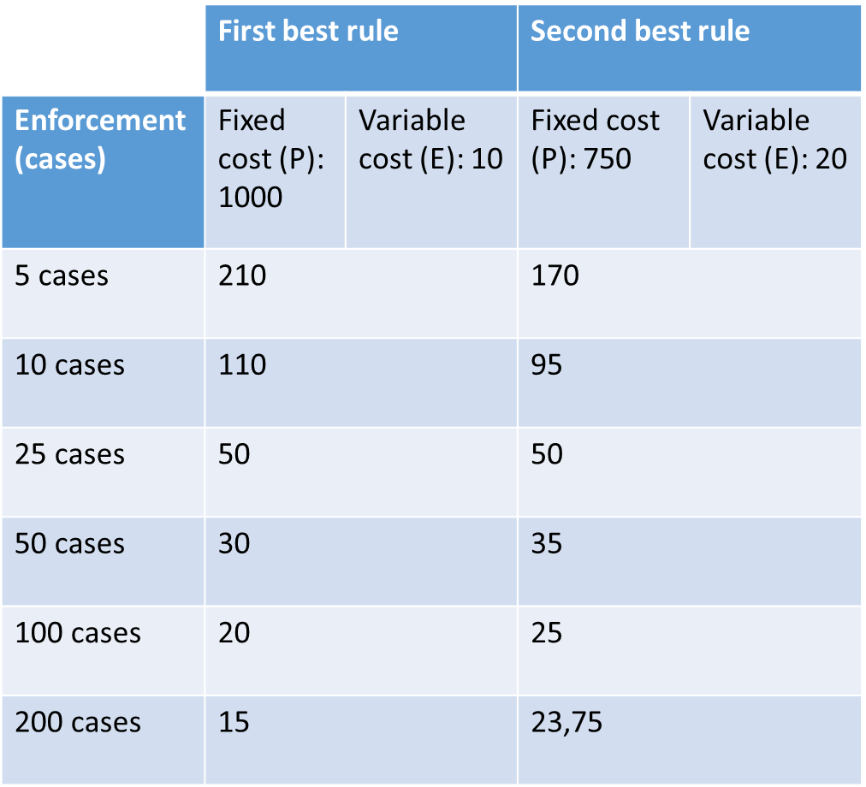
3. Second Best FRAND Rules?
Numerical Example
Interdependence P-E
When P is high, rulemaker settles for second best rule, which does not entirely specify the content of the law
Enforcement proceedings burdened by discrete recurring charge on top of the variable cost of adjudication E
Which of ex ante P decrease or ex post E increase is higher?
Equivalence is not a given: distinct drivers of costs
Specific E costs: deference v reliance doctrine?

Slide 10
4. Models of (FRAND) rules
Model of rule influences P and E costs differentials
Traditional legal scholarship proposes many angles to address that issue

Slide 11
Hybrid rules
Continuum
« core » of certainty v « penumbra » of uncertainty (Hart)
« Approaches »: “states what factors [...] should be considered in arriving at a conclusion”
Rules that mix rules and standards
  15 Georgia Pacific factors
  Lower P but possibly higher E due to lack of « formal realizability »

Slide 12
Rules of obligation v rules of recognition
Primary v secondary rules (Hart)
Substantive v formal rules (Kennedy)
Dworkin: a “parking ordinance of the city of New Haven is valid because it is adopted by a city council, pursuant to the procedures and within the competence specified by the municipal law adopted by the state of Connecticut, in conformity with the procedures and within the competence specified by the constitution of the state of Connecticut, which was in turn adopted consistently with the requirements of the United States Constitution”.
Fictional FRAND-imposed rate regulation which controls licensing levels
CEN-CENELEC position paper on FRAND which proposes to defer to the outcomes generated by a reciprocal FRAND attitudes to licensing negotiations
P likely to be high for rule of obligation, E likely to be low
P likely to be low for rule of recognition, effect on on E is not clear:
  May be high when rule is complex (Dworkin example) and low when rule is simple
  2-directional effet on E

Slide 13
Strong v Weak Rules
A rule (and standard) has a trigger and a response, and both can be soft or hard (Schlag).
A “hard” rule says: if infringement of a valid patent is found, then injunction shall proceed
A “weak” rule says: if infringement of a valid patent is found, then injunction shall proceed unless the infringer raises a valid equity argument.
“Crystal” v “Mud” Rules (Reese): exception and equitable second guessing
Default rules and gap fillers in contracts
Waivers: Posner
IEEE-SA revised patent policy, and the practice negative Letter of Assurances (“LoA”)
Ex post enforcement remain bound to resolve legal questions (what is FRAND)
Ehrlich and Posner: “Again, however, some benefits of governance by rules are sacrificed by recognizing exceptions based on implicit use of an overriding standard”
Weak rules have high P costs, high E costs

Slide 14
Discovery v Distributional Rules
Distributional rules seek to affect reasonable sharing of surplus between parties
  25% rule in licensing transactions
Discovery rules trust that basic rules of the game will yield reasonable outcomes
Close but distinct from primary and secondary rules, because based on Hayekian idea of economically efficient outcomes
FRAND dot v FRAND range
Physics v Biology
Distributional rules
  High P and low E costs
  Necessity to design a rule that avoids over and under inclusion
  Risks of antitrust liability
Discovery rules
  Orange Book Standard
  Huaweï v ZTE
  Low P cost, 2-directional effect on E cost?

Slide 15
Conclusions
At a very high level, not a given that FRAND rules are superior to FRAND standards: empirical question that demands verification (frequency)
Due to interdependence of P and E, second best rules may also be very costly and Kaplow’s frequency hypothesis may not hold
Discovery and negotiation rules > distributional and obligation rules
More to follow in working paper

Slide 16
References
Kaplow, Louis. “Rules versus standards: An economic analysis.” Duke Law Journal (1992): 557-629.
Ehrlich, Isaac, and Richard A. Posner. "An economic analysis of legal rulemaking." The Journal of Legal Studies 3, no. 1 (1974): 257-286.
Diver, Colin S. "The optimal precision of administrative rules." The Yale Law Journal 93, no. 1 (1983): 65-109.

