Slide 1
Global competition amongst standards-setting organizations
Ashok GANESH
Director Innovation
LCII-TILEC Conference Innovation, Research and Competition in the EU: The Future of Open and Collaborative Standard Setting
2017-05-30

Slide 2
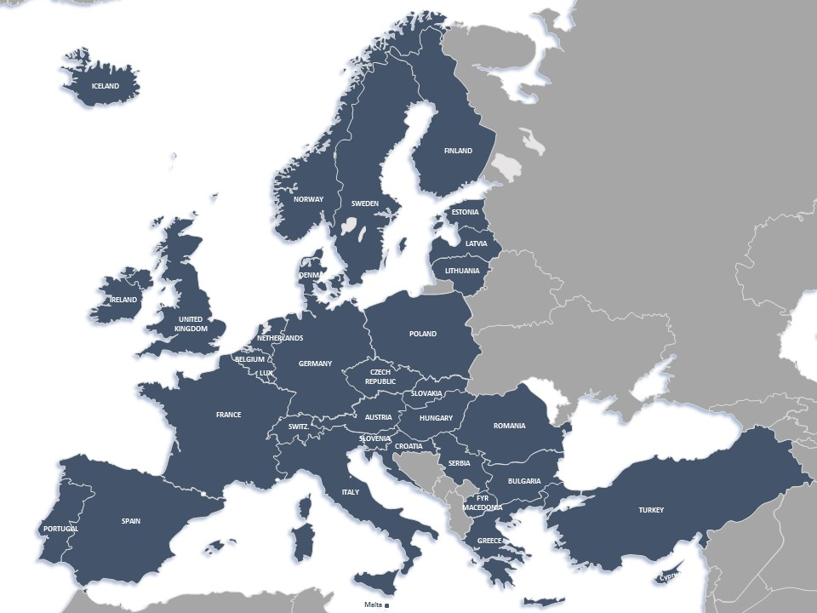

Slide 3
Fundamentals – CEN and CENELEC standards are…
Based on the national delegation principle
Representing a consensus among all interested parties, including industry & SMEs and societal stakeholders
Voluntary
Developed by independent organizations clearly distinct from authorities

Slide 4
Industry sector coverage

Slide 5
European Standards - Evolution
1960/1980 Industrialization
Product standards
Test Methods
1980/2000 Single market
Machinery safety
2010 – 2020 New (green) Technologies
Eco-design
Pressure equipment
Lifts
2000/2010 Processes & consumers
ICT convergence
>2020
Services?
System of systems?
Everything connected?
Digital economy?
Smart Cities
Construction
Renewable energy
Smart grids
Management Systems
Environment
Toy safety
eBusiness
IoT, Cyber…
…meeting stakeholder needs
Notes:
What standards do we then develop? The answer is simple: those standards that the stakeholders need. Over the years we have seen a considerable evolution in the nature of the standards that are needed by the market to support innovation.
The move towards a Single Market necessitated the production of standards that support the trade of goods across Europe, in a way that European Standards ensure that all products on the European market meet the necessary health and safety requirements.
The standardization of products meeting quality standards also expanded into having quality standards for the processes producing and delivering these products. We see management standards emerging and the emergence of the Internet also enables new concepts such as electronic business.
Today, in times of climate change and concerns about scarce resources, a lot of efforts go into designing products as energy-and-resource-friendly as possible, into renewable energy, into the use of ICT to optimize resources and so on.
And we can expect that the future, where everything will be connected to everything else, and our economy really goes digital, will require its own standards, Throughout this evolution, we will always produce the standards that the industry and society needs to make these changes.

Slide 6
The world is changing
European industry is digitizing
Traditional sectors now need IT standardization responses
Rapidly evolving regulatory landscape
Growing number of standardization providers
Notes:
CEN’s and CENELEC’s traditional ways of working may need to be reviewed in order to adapt to practices in the ICT domain (free availability, direct participation, ‘open source’ standards and ‘open platforms’)
European industry is digitizing its processes, systems and supply chains
Traditional sectors, not previously IT users, need IT standardization responses

Slide 7
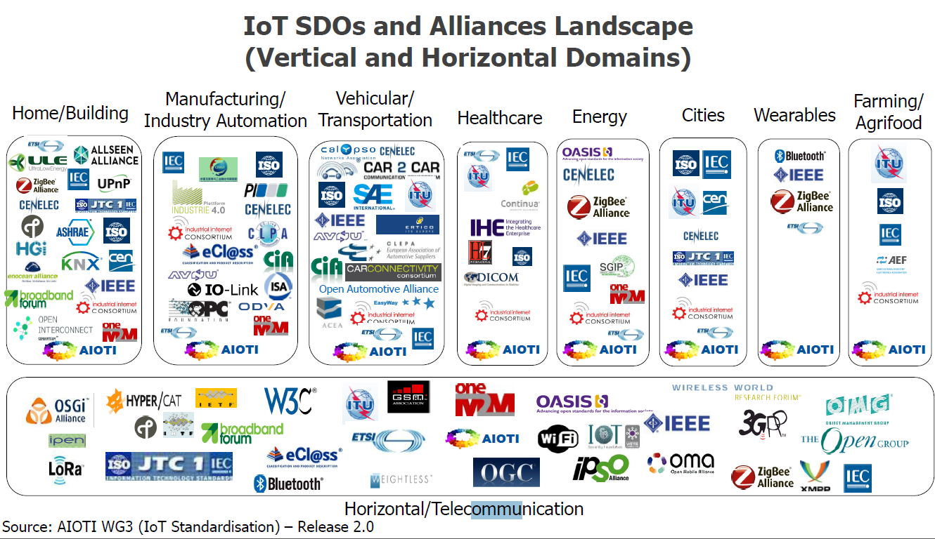
Standardization Bodies Supporting Digitization

Slide 8
Strategy for Digitization
CEN-CENELEC Ambitions 2020
Strategic Plan for Digitization
Implementing Projects

Slide 9
Digital Transformation
Online, collaborative standards development
Flexible, accessible online standardization platform
Strategic Alliances
ECSO, oneM2M, AIOTI
Digital transformation of CEN-CENELEC
Agile system, adaptable & flexible
21st Century standards content
Machine readable, Standards as Service
Next Generation
Digital professionals & Natives
Open Source Innovation & time to market
Notes:
Online standardization platform
Develop a solution for a seamless, user-friendly environment and collaborative platform for standardization work – aim is for joint development: ISO-IEC-CEN- CENELEC
21st Century Standards - Modernize the exploitation of standards’ content
To offer ‘standards as service’, identify options for digital exploitation of standards’ content, including machine readable content, ‘freemium’ enabling downstream actions including ‘smart compliance’ and ‘Smart CE marking’ and potential for proof-of-concept testing with stakeholders (e.g. through ‘plug-fests’). Identify potential for CEN and CENELEC members to offer extra and innovative services and features based on standards’ content. Establish feasibilities and make proposals for optimal solutions, aligning with the CEN – CENELEC IT Strategy and WG ‘Online standardization’.
Digital Transformation of CEN – CENELEC: Implement a flexible, adaptable CEN - CENELEC system (including CCMC)
Systematic review of structures, services, products and processes, identify potential and issue proposals to make the system more agile to identify and engage new digital opportunities (link with Technology Market Watch). Ensure efficient engagement mechanisms for new stakeholders and digital platforms, building on the approach for IoT pilot projects in 2017.
Strategic alliances and partnerships
Establish priority measures to ensure CEN and CENELEC are effective, credible leaders in the digital domain for standardization, including promoting a digital partnership ecosystem with industry platforms, PPPs, relevant fora/consortia, technology platforms.
Open Source Software Innovation
Quantify the potential and identify synergies and options to integrate standards with Open Source Software activities enabling access to a greater and more diverse set of contributors and maximizing innovation, efficiency and time to market.
Next Generation - Engage digital experts
Make proposals for a ‘by design’ approach to ensure the engagement of digital experts in CEN and CENELEC to support standardization in ‘traditional’ sectors and new digital standardization fields.

Slide 10
Open Source
From:
http://www.infosysblogs.com/infosysdigital/2016/06/open_source_software_wave_of_future.html
Open source drives innovation
Notes:
In case of parallel development of standard and OSS, there will be an implementation on the market at the same time as the standard
The experience when implementing the standard feeds back, leading to a better standard
More eyes on the code: you can also tap into academics resources (lots of brainpower) => they get visibility and recognition; our standardization process is anonymous
--------------
Open source has become the preferred way of developing new technology applications
The Cloud boosts open source development
Big internet companies (Google, Amazon, eBay, Facebook, LinkedIn, Netflix) support and/or using open source
Vast amount of source code available
But, importance and ubiquity of open source solutions make them big cybersecurity targets,
--------------
Increasing competition between open source development and standardization?
Apache (https://www.apache.org/foundation/) world's most popular OSS development platform = a standards consortium? (‘open…collaborative, consensus-based development process’
GitHub (https://github.com ) hosts 23 million OSS projects, with 14 million users
Standards are anonymous; being a valued wiki—contributor isn’t
“FRAND licenses create barriers for Open Source projects to implement the technical specification” (EC SWD(2013) 224 final)

Slide 11
Services ➔ Servitization
Notes:
Prof Andy Neely. A Product-Service System is an integrated product and service offering that delivers value in use.

Slide 12
The Future
Engaged
Agile
Market-driven

Slide 13
Ashok GANESH
aganesh@cencenelec.eu

