Slide 1
Global competition amongst Standard Setting Organizations (SSOs) LCII – TILEC Conference - Brussels May 30, 2017 Alfred Chaouat – Senior Vice President Licensing -Technicolor alfred.chaouat@technicolor.com

Slide 2
1 Two competing SSOs developped a blue laser optical disc*
* Technicolor is a member of these two SSOs
DVD Forum
BD Association

Slide 3
1.1 IP Regime for DVD Forum
Each participant to a working group had to execute the « Undertaking of Working Group Participants » :
Grant by Working Group participants to the Forum of a perpetual, irrevocable, and royalty-free license to copyrights, trade secrets and Know How
Commitment to grant a FRAND patent license for standard essential patents on condition of reciprocity from the licensee for its own standard essential patents

Slide 4
1.2 IP Regime for BD Association
Clause 15 of the BDA Charter : Patent IPRs (1/2)
In order to expedite the standardization process by the BDA, all Members commit themselves to the following policy in respect of the Patent IPRs.
(1) Each Member hereby agrees, on its behalf and on behalf of its Affiliated Companies, that it is willing to grant, or cause its Affiliated Companies to grant, to any interested party (“Potential Licensee”) a non-exclusive, non-transferable, world-wide licenses on fair, reasonable and non-discriminatory terms and conditions under any of the Essential Patents which the Member and its Affiliated Companies have the right to license and/or sublicense without obtaining approval from or paying compensation to a third party (“Full License Rights”) at the time of such Member’s accession to the BDA or thereafter, to use, sell, offer for sale, develop, manufacture, have manufactured, import or export or otherwise dispose of products that are in full compliance with any Blu-ray Disc Format, which has been adopted by the BDF or the BDA and has been made available to the public, provided that such Potential Licensee agrees in writing to offer equivalent licensing terms and conditions with respect to its Essential Patents, if any, in connection with such Blu-ray Disc Format.
(2) With respect to the Essential Patents which a Member or its Affiliated Companies own ts that are in full compliance with any Blu-ray Disc Format, which has been adopted by the BDF or the BDA and has been made available to the public, provided that such Potential Licensee agrees in writing to offer equivalent licensing terms and conditions with respect to its and its Affiliated Companies' Essential Patents in connection with such Blu-ray Disc Format.
(3) For the avoidance of doubt, this Clause 15 does not cover the Patent IPRs arising from or relating to any standard that has not been developed through the activities of the BDF or BDA but has been only referred to in any Blu-ray Disc Format, such as MPEG2 etc.

Slide 5
1.2 IP Regime for BD Association
Clause 15 of the BDA Charter : Patent IPRs (2/2)
(4) All Members, regardless of whether they do or do not join any established joint licensing program for the Essential Patents, agree that the aggregate of terms and conditions of all licenses necessary under the Members’ Essential Patents shall not block, frustrate or harm acceptance of any Blu-ray Disc Format as a worldwide standard or development of products complying with any Blu-ray Disc Format or commercialization of the same.
(5) Any dispute between a Member and another Member over whether the Member is offering a license under its Essential Patent(s) on fair, reasonable and non-discriminatory terms and conditions within the context of the provision of 15(4) shall be decided by a single neutral arbitrator appointed under the International Rules of the American Arbitration Association (the “Arbitrator”) and will be conducted under the rules of that Association in New York City. The arbitration hearing shall take place no later than ninety days after the arbitrator is selected and a decision shall be rendered within thirty days of the completion of the hearing. In evaluating the reasonableness of the disputed terms and conditions, the Arbitrator shall take into account, among other things, terms and conditions (including but not limited to applicable license fees) of joint license programs and individual license programs within the area of licensing essential patents for optical disc systems, where:
(i) such terms and conditions; and
(ii) such optical disc systems
are generally accepted by the optical disc systems industry.

Slide 6
2 Two competing SSOs develop the next generation video codec successor to HEVC
*Moving Picture Expert Group. Technicolor is part of MPEG
MPEG* – H266
Alliance for Open
Media (AOM)

Slide 7
2.1 MPEG
MPEG has developed so far all video codecs used in the CE industry starting with MPEG 1 and followed by MPEG 2 Video, H264 (AVC) and H265 (HEVC) which is under deployment. There are more than 300 members contributing to the new specifications
IP regime is a commitment to grant a FRAND patent license for standard essential patents
MPEG Chairman tried recently unsuccessfully to introduce a royalty free baseline profile for H266

Slide 8
2.2 AOM
AOM was announced on September 1, 2015
Founded in reaction to the complicated licensing landscape for HEVC (3 different patent pools + individual licensors) and the willingness of some of the pools to charge the content industry. Less than 30 members so far. Very much US centric …
The below statement is posted on AOM website
The initial project – AOMedia Video – pursues a new, royalty-free video codec specification and open source implementation based on the contributions of Alliance members and the broader developer community, along with binding specifications for media format, content encryption and adaptive streaming
Extract from this SSO IP rules
Participants in Alliance for Open Media Working Groups have adopted the Alliance for Open Media Patent License 1.0. This is intended to fulfill their commitments to make available their Essential Claims, as defined in the W3C Patent Policy, in Final Deliverables adopted by that Working Group under the W3C RF licensing requirements as if that Final Deliverable was a W3C Recommendation.

Slide 9
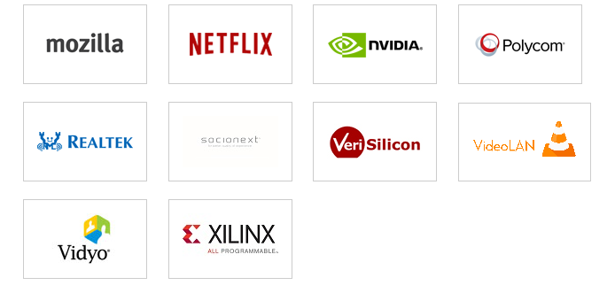
2.2 AOM

Slide 10
2.3 Points for discussion
To which extent a royalty free video codec could really become royalty free
Performance of a royalty free video codec versus the royalty bearing video codec
Whether competing video codecs could co-exist on the market (or if it will necessarily end up into a format war such as the VHS / Betamax one or more recently the HD-DVD / BD format war)

Slide 11
3 Some other competing SSOs
/
/
/

Slide 12
Thank you for your attention

