Slide 1
Patent hold-up and the «antitrustization» of FRAND: a multi-sided reappraisal?
Professor Nicolas Petit, University of Liege
LIEN, Nanterre, 18 June 2015

Slide 2
Goals of the presentation
Patent hold-up
The « antitrustization » of FRAND, or FRAND as source of antitrust liability and remedy
A reappraisal: FRAND as matching device on multi-sided platforms

Slide 3
I. Patent Hold-Up

Slide 4
1. Market developments
2001, NTP sues RIM for patent infringement, $612.5 million settlement
2011, Global patent war

Slide 5
Apple filing of design patents (January 2007)

Slide 6
Apple filing of design patents (June 2007)

Slide 7
Apple v Samsung litigation (2011)

Slide 8
The global patent war
Patent owners enforce their IPRs and seek injunctions in courts across the world (to obtain removal of infringing products)
Some patents are core to standardized technologies (though not all) => SEPs (ex. IEEE 802.11 Wi-Fi standard)
Some SEPs are encumbered by a FRAND commitment
Some of those players are patent trolls, or non practicing entities (NPE) or patent assertion entities (PAE): NTP, Intellectual Ventures, etc.

Slide 9
2. Academic developments
Papers
Idea
Shapiro, “Navigating the Patent Thicket: Cross Licences, Patent Pools and Standard Setting”, non formal policy paper of 2001
Shapiro, “Injunctions, Hold-up and Patent Royalties”, Formal economics working paper of 2006 later published in American Law and Economics Review
Shapiro and Lemley, “Patent holdup and royalty stacking”, Interdisciplinary paper of 2007
Focus on ICT where products integrate multiple patented components
“injunction threats” entitle patent holders to “negotiate royalties far in excess of the patent holder’s true economic contribution”
Severe in the case of “private standard setting”, because “it is extremely costly or even impossible as a practical matter to “redesign” a product standard to avoid infringing a patented technology”
“Patent surprise” scenario (implementer ignored there was a patent) as well as “early renegotiation” (implementer knew there was a patent)

Slide 10
3. Legal recognition of patent hold up
Horizontal cooperation guidelines, §269: IPR owners can “behave in anti-competitive ways, for example by ‘holding-up’ users after the adoption of the standard”
Reference to §269 of the HCG in footnote 32 of the Google/Motorola Mobility Merger Decision of 2012
Reference to “hold-up” in two press releases of 2012 in Samsung and Motorola
Reference to §269 of the HCG in 2014 Samsung (§39) and Motorola decisions (§§76, 77 and 289)
Cited by AG Wathelet in Huaweï v ZTE
Soft law turned to hard law?

Slide 11
II. FRAND « antitrustized »?

Slide 12
Issue
Antitrust agencies’ view of FRAND pledges as anti-hold-up tools by patent owner, HCG §287, Motorola §77, Samsung §40 => distributional purpose
But issue is that FRAND pledges have no teeth: mere paper-tiger, courtesy obligation;
Let’s turn FRAND pledges into antitrust theory of liability and source of antitrust remedy!
(+ Let’s encourage (standardize) them, HCG as good practice)
Antitrust empowerment of FRAND

Slide 13
Two possible approaches
FRAND as source of antitrust pricing discipline?
FRAND as source of antitrust conduct obligations
Verify if licensing terms are un-FRAND, and consider the price level abusive => outcome interpretation of FRAND commitments
Agencies have repugned to do this
Qualcomm case, 2007
Commission has embraced this interpretation
FRAND creates « exceptional circumstances »
SEP holder can no longer seek injunction in courts (agst implementer that is not unwilling)
SEP holder can no longer introduce non-challenge or termination clauses in contract
SEP holder must take very « specific steps »: Samsung « licensing framework » and Wathelet’s « Guidelines »

Slide 14
The law
Commission Decision, Samsung – Enforcement of UMTS Standard Essential Patents, 29 May 2014, AT 39939 (Article 9) (Apple complaint)
Commission Decision, Motorola – Enforcement of GPRS Standard Essential Patents, 29 May 2014, AT 39985, (Article 7) (Apple complaint)
Preliminary reference before the CJEU, Huawei v ZTE, C-170/13, Opinion of AG Wathelet, 20 November 2014

Slide 15
Legal problem with FRAND « Antitrustization »
External controversies
Internal inconsistency
No explanation why FRAND creates « exceptional circumstances »
Discussion axed on national law concepts
Contract or quasi-contract?
Moral promise?
Estoppel theory or waiver principle?
« License of right », AG Wathelet, §65
Example: the German quagmire
DE test is whether there’s « willing licensee »
FSC, Orange Book Standard; Request under Article 15 of Regulation 1/2003, Judge Andreas Voß request in Motorola v. Apple, November 2013; Preliminary reference before the CJEU, Huawei v ZTE, C-170/13, Dusseldörf Court
Antitrust tends to consider that unilateral announcement of pricing intentions not liable to create assurances on which third parties can rely and make design choices (Woodpulp, Bayer, etc.)
Well settled that for price announcements to trigger antitrust exposure, strategic information must be disclosed: FRAND too abstract in content?

Slide 16
Economic problem with FRAND « antitrustization »
The current antitrust interpretation of FRAND as a source of strict conduct obligations seeks to prevent hold-up, rather than remedying it when it occurs
This theory assumes, conjectures, predicts hold-up is inevitable result of un-FRAND SEPs owner conduct
Normative assumption devoid of support
Weak theoretical evidence: extrapolation of Shapiro papers
No antitrust remedy => stay injunctions until redesign has taken place;
Heavy focus on non-integrated innovators (trolls)
Weak empirical evidence:
Joshua Wright, “Evidence-Based Antitrust Enforcement in the Technology Sector”, enforcement should be “disciplined by empiricism”
ICT sector, public enemy N°1 for both abolitionists – innovation is said to be hampered by patents – and reformists – view that weak patents and thickets plague the sector

Slide 17
Prices (Galetovic, Haber and Levine, 2014)

Slide 18
EU Commission Joint Research Centre
Data retrieved from EU Industrial R&D Investment
SCOREBOARDS 2009-2013

Slide 19
EU Commission Joint Research Centre
Data retrieved from EU Industrial R&D Investment
SCOREBOARDS 2009-2013

Slide 20
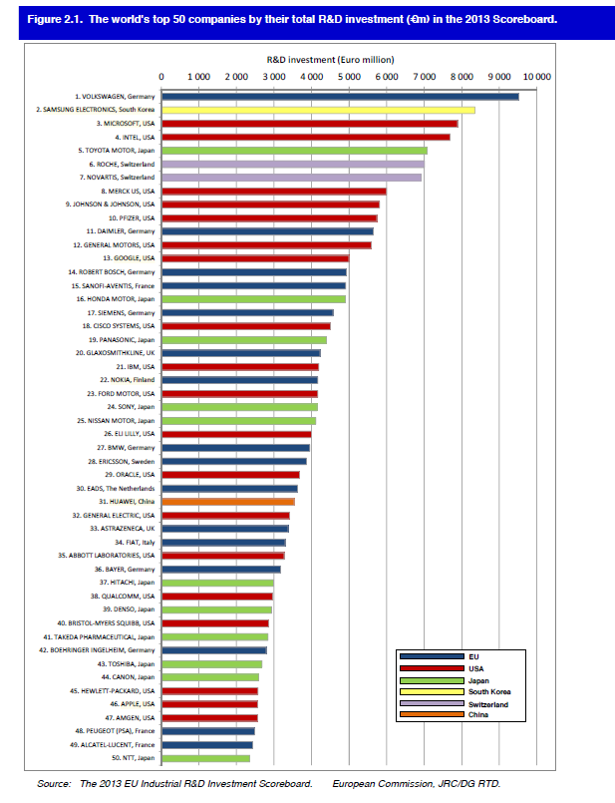
Number of ICT firms in top 40 (and rank)
Samsung (2)
Microsoft (3)
Intel (4)
Google
Cisco
IBM
Nokia
Sony
Ericsson
Oracle
Huawei
Qualcomm

Slide 21
III. FRAND commitments, a multi-sided reappraisal?

Slide 22
Intuition
Distributional purpose of FRAND (avert hold up by patent owner) is misguided
FRAND is primarily a matching (or courting) device on a multi-sided platform
Classic cross-platform positive externality, cuts both ways
Developers positively impacted by presence of implementers on the other side: technology dissemination
Implementers positively impacted by presence of developers on the other side: faster conception, increased technology selection, avoid inadvertent infringement
SSOs face the well-known challenge « to bring all sides on board »
Bring as many implementer, to convince developpers to join
Bring as many developpers, to convince implementers to join

Slide 23
FRAND AS a matching mechanism
SSOs have no obvious instruments of cost allocation or cost subsidization to bring technology developers and implementers on board
A priori, far from the canonical multi-sided platform where some users (advertisers) are charged and others are not (eyeballs)
But platforms may also interfere on transaction prices between users to promote participation to the platform (Rochet and Tirole, “Defining Two-Sided Markets”, 2004)
In particular, transaction between buyer and user must not involve a “price determined through … monopoly price-setting”
And this matters on both sides: A SSO must obtain “enough commitments from these owners (reasonable royalties, exact implementation of the technology, treatment of future innovation, etc.) in order to convince various potential users (e.g., consumer electronics and software companies) to invest in the technology, while also making it attractive for each and every intellectual property owner to get on board” (Rochet and Tirole, “Defining Two-Sided Markets”, 2004)
Major implications for antitrust policy

Slide 24
Superiority
Avoidance of lengthy legal controversies that originate in national law
Places the debate on antitrust territory: monopoly power

Slide 25
FRAND has two sides
FRAND seeks to rein in monopoly price setting on technology developper side but also on the implementer side
FRAND thus also embodies concern for monopsony power, or group-monopsony power
Antitrustization of FRAND is appropriate but focus of antitrust agencies should not only be on developper (selling) side
SSOs and antitrust agencies to be cautious in relation to licensing initiatives driven by implementers => IEEE, DoJ Business Review Letter, 2015?

Slide 26
IEEE, DoJ Business review letter, February 2015
SEP holder « shall neither seek nor seek to enforce … prohibitive order »
Definition of « reasonable rate »: « shall mean appropriate compensation … excluding the value, if any, resulting of the inclusion of [the patent’s claim] technology in the IEEE standard » => switching cost
Three recommended factors for valuation
Value that claimed invention « contributes to the smallest saleable compliant implementation »
Value in light of all « essential patent claims for same IEEE standard »
« Existing licences covering use of the essential patent claims », provided they were not negotiated under threat of prohibitive order

Slide 27
Refine understanding of « monopoly price- setting » in SSOs
Is detention of SEP source of monopoly power?
Standardization in ICT features hybrid participants, where technology developers are at same time implementers who buy technology
Innovation in ICT is combinational, so pure technology developers need cross licensing from each other if they want to keep developing technology
Standardization in ICT is ephemeral, with rapid pace of technological innovation => 2G, 3G, 4G (>< barcode)
Repeated game with punishment mechanisms
Market dominance but no permanence (Motorola decision, GPRS and EDGE not substitutes!)
Pricing component products with neighbouring monopoly manufacturers => mutual Cournot moderation

Slide 28
The price problem
Fallacy that there is one FRAND pixelized price point
There are many distributional price points below the monopoly price
What matters is that price is not above what the market can bear

Slide 29
Tirole and Lerner, 2014
Standard Essential Patents
Structured price commitments
SSOs have two functions (i) essentialization and (ii) regulation
Lack of price commitment
Framework to reveal the price that would follow ex ante competition
Discovery phase
Recess before standard finalization
Firms commit to prices (caps)
Final choice made
Structured price commitment comes on top of FRAND (if failure of discovery), FRAND remains important
Owners of SEPs may forum shop, to avoid structured price commitments
Hence, need to make them mandatory
Problem with multidimensional pricing

Slide 30
Welfare assessment should focus on participation of SSO membership
Multi-sided market theory predicts that price structure has effect on SSO participation
Hold-up or hold-out hypothesis should be validated or contradicted through that metric
More empirical research is needed
Change in SSO participation following change in SSO licensing policy?
VITA 2007, IEEE 2015, etc.
RF to FRAND?
ISO v other standards
Increase in standards wars in ICT?

Slide 31
Conclusion
Need to change approach of FRAND: not distributional but output-centered
FRAND is pricing structure that seeks to « get all sides on board »
Admission that risks can arise (and scrutiny) on buyer side too

Slide 32
Follow me on twitter @CompetitionProf
Papers available @ http://papers.ssrn.com/sol3/cf_dev/AbsByAuth.cfm?per_id=358753

