Slide 1
Transparency, Predictability and Efficiency of SSO-based Standardization and SEP Licensing
LCII-TILEC conference, 30 May 2017

Slide 2
CRA study
The CRA study makes concrete proposals for improving the efficiency of the standardization process and SEP licensing.
The CRA study builds on comments and ideas that were gathered from a variety of stakeholders, and in particular:
The consultation exercise organised by DG Growth before the launch of this research project, to which 40 stakeholders responded.
A set of 36 hour-long interviews, and:
A workshop organised at CRA’s Brussels offices, with participants representing 17 companies.
Stakeholders included representatives from industry (ICT, Automotive, Machine Tools,…), SSOs, patent pools, academia, trade associations, patent offices and public authorities.
Different points of views and interests of stakeholders (e.g. patent-holders versus implementers, whether the respondent is from a complex, patent-dense industry) taken into account for designing policy recommendations.

Slide 3
The “Spirit” of the Study
This is not about “who should get the rents” : try to propose a “package” of measures that overall makes all parties better off, not compared to their own preferred scenario but compared to the status quo.
Preserving flexibility along dimensions where economic analysis is inconclusive and/or suggests that there is no “one size fits all” solution.
Propose a “package” of measures but allow for different approaches in different industries.
Guidance rather than formal obligations.
Keeping things simple.

Slide 4
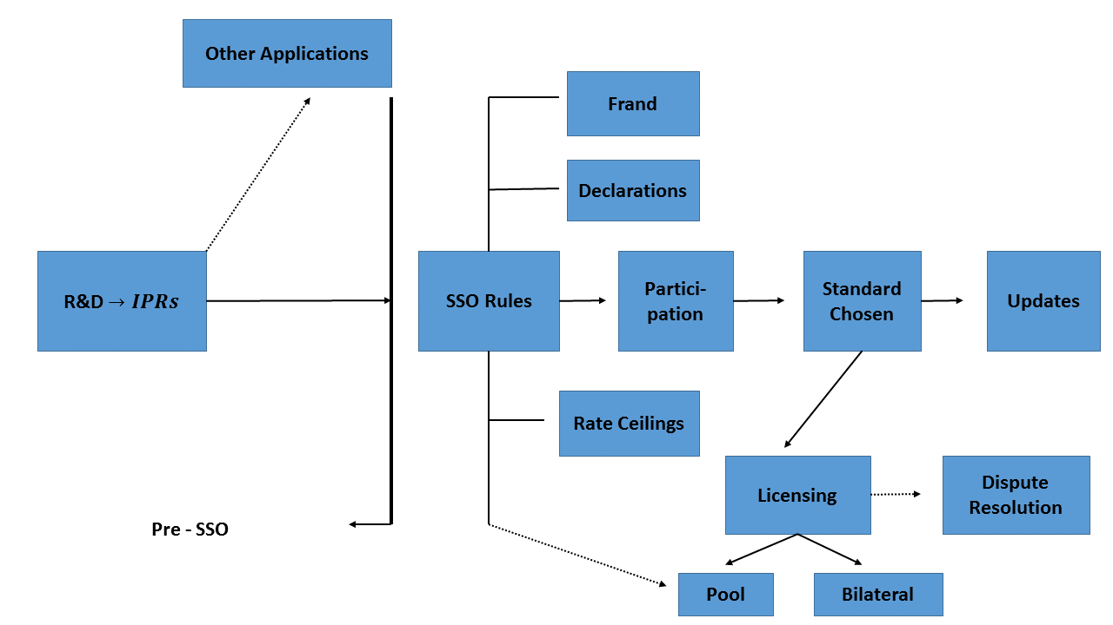

Slide 5
Expected stake-holder views (issues)
 | Complex Industries |  | Agreement?
 | SEP-Holders | Implementers
Hold-Up and Ambush | Play down practical importance of these issues | Emphasise the damage resulting from these issues | NO
Reverse Hold-Up and Hold – Out | Insist on the need to recover large R&D investments. See unwilling licensees as a pervasive problem | Not a significant issues. Courts are well armed to deal with hold-out. | NO
Royalty-Stacking | A problem but one that should be addressed collectively | Same as SEP-owners | YES, in principle.
Choice of Standard | Favour a choice based on technical criteria only | Favour the introduction of economic considerations (i.e. best quality price ratio) | NO
Transaction Costs | Favour reduction | Favour reduction | YES on overall reduction in transaction costs/uncertainty but opposing interests about the sharing of costs and benefits

Slide 6
Mapping Policies to Issues
(Negative) Ex Ante Declaration + Frand Commitment
Hold-Up
Hold-Out
Clarify Duties in Negotiation (Huawei)
Stacking
Ex Ante Commitment to / Indication of maximum Total Stack
Transparency of Licensing Process
Patent Pools
Too many SEPs/ Essentiality
Royalty Base
PTO(?) Database and Essentiality Tests
Level of Licensing
Allocate “total stack” according to number of SEPs and average quality of portfolio
Licensing Practices
Portfolio Licensing
Injunctions
“baseball-type” arbitration
Litigation
Arbitration

Slide 7
Considered Policy Options
Commitments
Disclosure
Licensing

Slide 8
Commitments – FRAND
Mean to address hold-up: hold-up may arise when there is no commitment on terms and conditions before the standard is set.
FRAND constitutes an ex-ante commitment to limit ex-post market power.
Conceptual definition: agreement that a given patent-holder and a given licensee would have struck if they had signed a licensing deal before any of the features of the standard were set.
Since different licensees have different needs, possibility that an agreement would be reached ex-ante on different royalty and licensing conditions (but “ND” part of FRAND...)
FRAND rates may be quite high for some portfolios: if some technologies are hard to design around, patent-owner may have considerable bargaining power, even ex-ante.
Potential role for SSO? E.g. regarding specific clauses not being considered FRAND or arbitration related to FRAND.

Slide 9
Commitments – Royalty caps
Royalty caps
Ex-ante commitment on maximum royalty rate/conditions at which IPRs would be available if they happen to read on the chosen standard.
Potential benefits: make it possible to consider possible trade-offs between technological excellence and economic efficiency.
Individual caps
Typically apply to entire portfolio of the declaring member.
Reintroduce some form of ex-ante competition between technologies considered for a standard to alleviate hold-up issue.
Aggregate caps
Can alleviate both hold-up and royalty stacking.
Alleviates hold-up if competition between standard-setting is a possibility.
Directly addresses the stacking issue (coordinated pricing of strict complements may limit excessive pricing by individual licensors).

Slide 10
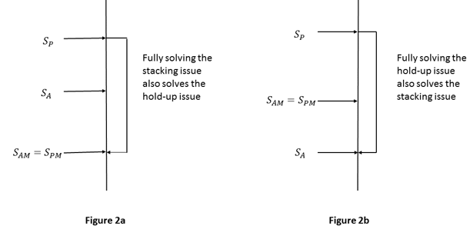
Comparison of ex-ante and ex-post royalty stacks

Slide 11
Disclosure
Ex-ante disclosure
Necessary complement to FRAND and royalty commitments (since IPRs to which such commitments apply need to be identified).
Specific declaration: identifies all patents that patent-holder believes to be relevant for the standard to be designed.
Negative declaration (linked to a commitment): patent holder only identifies patents not available at committed conditions (e.g. FRAND).
Should aim at limiting transaction costs and addressing over-declaration.
Ex-post disclosure
Identification of patents that are deemed to read on the standard (necessarily specific).
To lower uncertainty affecting the licensing process and transaction costs of licensing negotiations.
External essentiality assessments can be a useful complement (e.g. random sampling).

Slide 12
Licensing (1)
Patent transfer rules
Patent holder selling all or part of SEP portfolio to third parties, such as NPEs.
General agreement that purchasers of portfolios should be bound by prior FRAND commitments (otherwise FRAND commitments not worth much).
But should they be bound by the previous owner’s interpretation of FRAND (i.e. can they charge more while claiming it is still respecting FRAND)?
Transfer that goes against reasonably formed expectations may lead to additional hold-up issue.

Slide 13
Licensing (2)
Portfolio licensing
Reduce transaction costs for both licensors and licensees.
Combination of SEPs and non-SEPs (or cross licensing) to circumvent FRAND commitments?
Not found to be a major issue by respondents.
Issue does not arise as long as patent-holder makes a mixed bundling offer (i.e. there is also an offer on the SEP portfolio only).
Patent Pools
Patent pools typically charge a single overall royalty to licensees.
Can address stacking + reduces transaction cost (“one-stop” shopping).
In practice, limited: need agreement on the sharing rule and royalty level, diverging interest of patent-holders (some of which may also be implementers) plus set-up costs.
SSO can encourage voluntary formation of patent pools (e.g. by appointing a pool management company early).

Slide 14
Licensing (3)
The royalty base
A first principle is that a given total payment can be expressed in terms of a broad base (with a low rate) or with a narrow base (with a high rate).
Second principle: the base should be closely related to the part of the final good’s value which is affected by the technology included in the SEP.
Efficient choice of the base depends on the characteristics of the technology (e.g. smartphones versus cars), and hence it makes little sense to mandate a single type of royalty base (such as the “smallest tradable unit” or total value of the good).
Vertical level of licensing
First principle: does upstream licensing significantly affect the ability to discriminate across fields of use (e.g. if chips used are similar across applications)?
Second principle: minimizing transaction costs (e.g. less costly to negotiate upstream if more concentrated).

Slide 15
Licensing (4)
SSO policies on dispute resolution
Courts are last resort to put content into FRAND and determine whether commitments have been honored.
Courts are building and clarifying over time their approach for solving FRAND disputes.
Mixed views on making alternate dispute resolution (arbitration and mediation) mandatory: many fear of being deprived of legal rights to go to court, and highlight that courts are better placed to rule on infringement and validity.
There is however a role for encouraging arbitration/mediation regarding “simpler” disputes on the level of royalties.
Such dispute resolution must then be properly designed (e.g. “high-low” versus “baseball” or “night baseball” mechanisms). Plus value in having the decisions published.

Slide 16
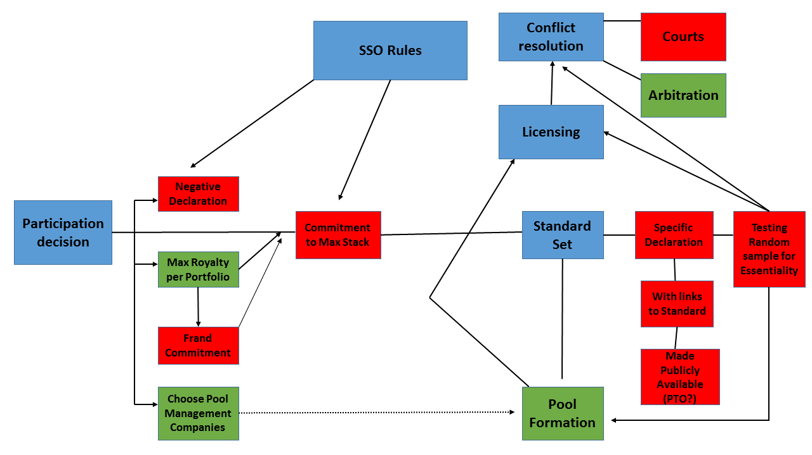
Illustration of proposed policies

Slide 17
Reference
Transparency, Predictability and Efficiency of SSO-based Standardization and SEP Licensing, A Report for the European Commission, prepared by Pierre Régibeau, Raphaël De Coninck and Hans Zenger, June 2016 (published on 12 December 2016 on DG GROW's website).

Slide 18
Raphaël De Coninck rdeconinck@crai.com Tel +32 (0)2 627 1401 +32 (0)492 738010 Brussels Tel +32 (0)2 627 1400 143 Avenue Louise B-1050 Brussels Belgium London Tel +44 (0)20 7664 3700 99 Bishopsgate London EC2M 3XD United Kingdom Munich Tel +49 89 20 18 36 36 0 Leopoldstraße 8-12 80802 München Germany Paris Tel +33 (0)1 70 38 52 78 27 Avenue de l’Opéra 75001 Paris France

